Slide 1
Unit-1 Introduction to Data Structure
Data Structures (DS)
GTU # 3130702

Slide 2

Looping
Outline
Data Management concepts
Data types
Primitive
Non-primitive
Types of Data Structures
Linear Data Structures
Non Linear Data Structures
Performance Analysis and Measurement
Time analysis of algorithms
Space analysis of algorithms

Slide 3

What is Data?
Data is the basic fact or entity that is utilized in calculation or manipulation.
There are two different types of data Numeric data and Alphanumeric data.
When a programmer collects such type of data for processing, he would require to store them in computer’s main memory.
The process of storing data items in computer’s main memory is called representation.
Data to be processed must be organized in a particular fashion, these organization leads to structuring of data, and hence the mission to study the Data Structures.

Slide 4

What is Data Structure?
Data Structure is a representation of the logical relationship existing between individual elements of data.
In other words, a data structure is a way of organizing all data items that considers not only the elements stored but also their relationship to each other.
We can also define data structure as a mathematical or logical model of a particular organization of data items.
Data Structure mainly specifies the following four things
Organization of Data
Accessing Methods
Degree of Associativity
Processing alternatives for information

Slide 5
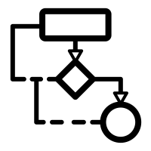

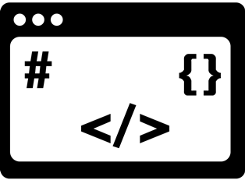
What is Data Structure? Cont..
The representation of a particular data structure in the memory of a computer is called Storage Structure.
The storage structure representation in auxiliary memory is called as File Structure.
Algorithm
Data Structure
Program

Slide 6
Classification of Data Structure
Data Structure
Primitive Data Structure
Non-Primitive Data Structure
Integer
Characters
Linear List
Non-linear List
Floating
Point
Pointers
Static
Dynamic
Graphs
Trees
Arrays
Arrays
Lists
Stack
Queue

Slide 7
Primitive / Non-primitive data structures
Primitive data structures
Primitive data structures are basic structures and are directly operated upon by machine instructions.
Operations such as a+b maps directly to single machine instruction(e.g., ADD R1, R2). Their size (e.g., int = 4 bytes) is hardcoded into CPU architecture
Integers, floats, character and pointers are examples of primitive data structures.
Non primitive data structure
These are derived from primitive data structures.
The non-primitive data structures emphasize on structuring of a group of homogeneous(same) or heterogeneous(different) data items.
Examples of Non-primitive data type are Array, List, Stack, Queue, Tree and Graphs
Static Data Structures: They have a fixed size. The memory is allocated at the compile time, and its size cannot be changed by the user after being compiled; however, the data can be modified. e.g. array
Dynamic Data Structures: They don't have a fixed size. The memory is allocated at the run time, and its size varies during the execution of the program. Moreover, the user can modify the size as well as the data elements stored at the run time. e.g. linked list, stack, queue

Slide 8
Array
Array: An array is a fixed-size sequenced collection of elements of the same data type.
The elements of array will always be stored in the consecutive (continues) memory location.
The number of elements that can be stored in an array, that is the size of array or its length is given by the following equation:
The first element of the array has index zero[0]. It means the first element and last element will be specified as: arr[0] & arr[4] respectively for an array of size 5.
(Upperbound - lowerbound)+1
0 1 2 3 4
For the above array it would be (4-0)+1=10,
Array

Slide 9
For example: Reading into an array For example: Writing/printing an array
for(i=0;i<=9;i++) for(i=0;i<=9;i++)
scanf(“%d”,&arr[i]); printf(“%d”, arr[i]);
If we are reading or writing two-dimensional array it would require two loops. And similarly the array of a N dimension would required N loops.
Some common operation performed on array are:
Creation of an array
Traversing an array
Insertion of new element
Deletion of required element
Modification of an element
Merging of arrays

Slide 10
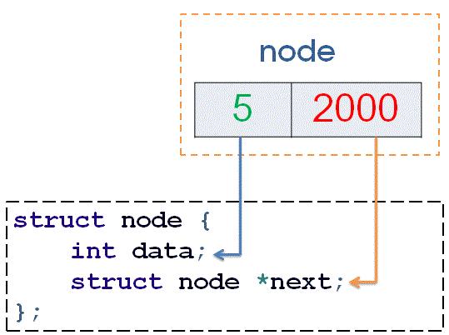
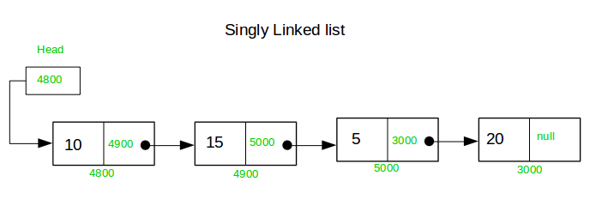
Link List
Link List: An ordered set containing variable number of elements is called as Lists.
A lists (Linear linked list) can be defined as a collection of a variable number of data items.
Lists are the most commonly used non-primitive data structures.
An element of the list must contain at least two fields, one for storing data or information and the other for storing address of the next element.

Slide 11
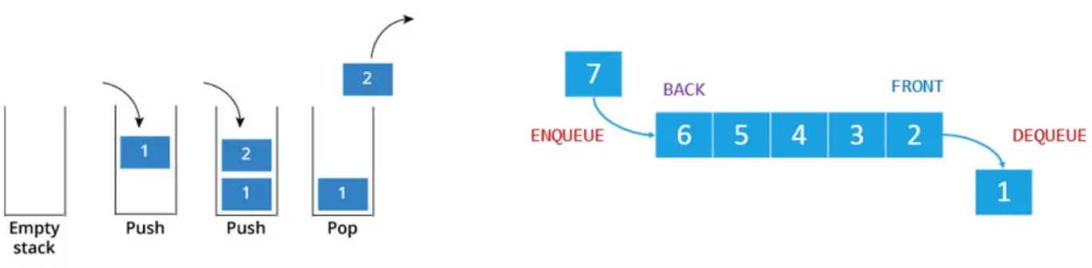
Stack and Queue
A stack is also an ordered collection of elements like arrays, but it has a special feature that deletion and insertion of elements can be done only from one end called the top of the stack (TOP)
Due to this property it is also called as last in first out type of data structure (LIFO).
Queue is a first in, first out (FIFO) type of data structure
In a queue, new elements are added to the queue from one end called the REAR end, and the element is always removed from the other end, called the FRONT end.

Slide 12
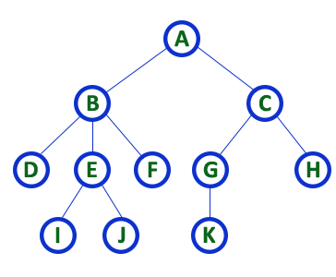
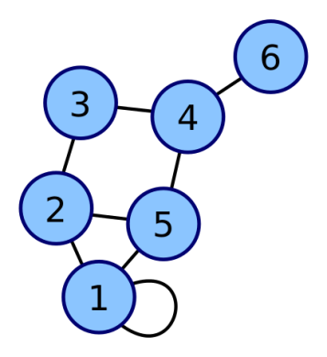
Tree and Graph
Tree data structure is a hierarchical structure that is used to represent and organize data in the form of parent child relationship.
There is a special data item at the top of the hierarchy called the Root of the tree.
A Graph in Data Structure is a collection of nodes that consists of data and are connected to other nodes of the graph.
An edge connects a pair of vertices and many have weight such as length, cost and other measuring instruments according to the graph.
Tree
Graph

Slide 13
Operations of Data Structure
Create: It results in reserving memory for program elements.
Destroy: It destroys memory space allocated for specified data structure.
Selection: It deals with accessing a particular data within a data structure.
Updation: It updates or modifies the data in the data structure.
Searching: It finds the presence of desired data item in the list of data items.
Sorting: It is a process of arranging all data items in a data structure in a particular order.
Merging: It is a process of combining the data items of two different sorted list into a single sorted list.
Splitting: It is a process of partitioning single list to multiple list.
Traversal: It is a process of visiting each and every node of a list in systematic manner.

Slide 14
Real-life applications of data structures:
You have to store social network “feeds”. You do not know the size, and things may need to be dynamically added.
You need to store undo/redo operations in a word processor.
You need to evaluate an expression.
You need to store the friendship information on a social networking site. i.e., who is friends with who.
You need to store an image (1000 by 1000 pixels) as a bitmap.
To implement printer spooler so that jobs can be printed in the order of arrival.
Linked list or dynamic array (Python list or Java ArrayList)
2 stacks.
Stack.
Graphs.
2-D Array.
Queue.

Slide 15
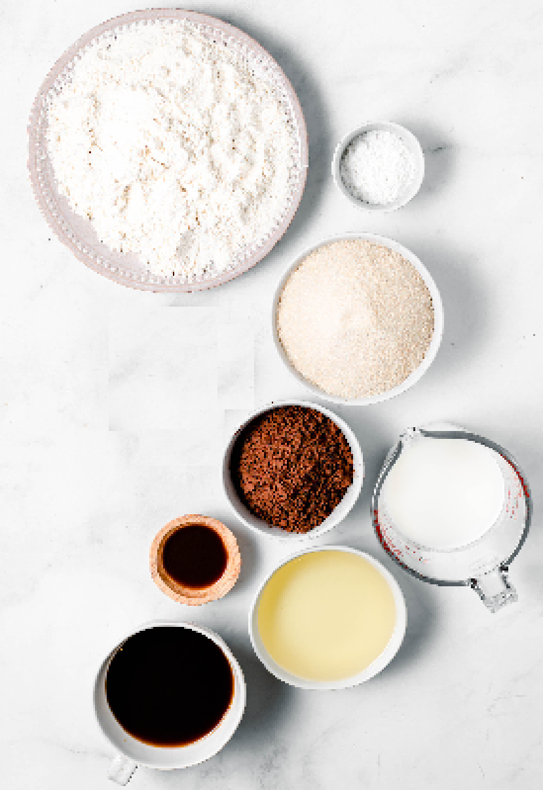


What is an Algorithm?
A step-by-step procedure, to solve the different kinds of problems.
Suppose, we want to make a Chocolate Cake.
An unambiguous sequence of computational steps that transform the input into the output.
Input
Process
Output
Ingredients
Recipe
Cake

Slide 16



What is an Algorithm?
A process or a set of rules to be followed to achieve desired output, especially by a computer.
An algorithm is any well-defined computational procedure that takes some value, or a set of values as input and produces some value, or a set of values as output.
Input
Algorithm
Program
Output

Slide 17

Googol-to-One Gear Ratio
Daniel Bruin built a machine with 100 gears with a 10-to-1 gear ratio…meaning that the overall gear ratio is a googol-to-one. (A googol is 1 with 100 zeros.)
1 rotation of 1st gear =10 second
10 rotation of i^{th} gear turns 1 rotation of (i+1)^{th}

Slide 18
Why Performance Analysis?
The performance of an algorithm can change with a change in the input size.
Performance of an algorithm may not matter much for small input size, but when the input size increases, performance can not be ignored.
Many real-time and mission-critical applications might result in problems if results are not produced within a specific time.
Algorithms should be optimized.

Slide 19
What are Asymptotic Notations?
Asymptotic Notations are languages that allow us to analyze an algorithm’s run-time performance.
Asymptotic Notations identify running time by algorithm behavior as the input size for the algorithm increases.
This is also known as an algorithm’s growth rate. Usually, the time required by an algorithm falls under three types −(Ex. searching)
Best Case − Minimum time required for program execution
Average Case − Average time required for program execution.
Worst Case − Maximum time required for program execution.

Slide 20
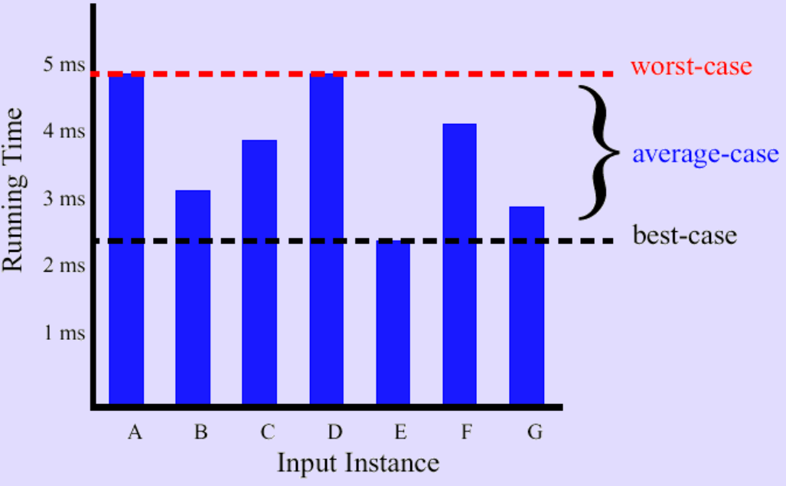
Best/Worst/Average Case
For a specific size of input n, investigate running times for different input instances:

Slide 21
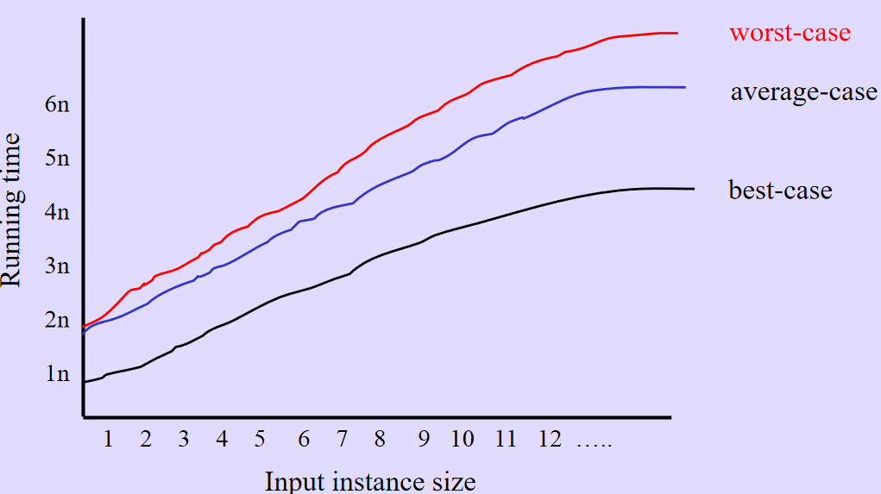
Best/Worst/Average Case
For inputs of all sizes:

Slide 22
Types of Asymptotic Notations
Commonly used asymptotic notations to calculate the running time complexity of an algorithm.
Ο Notation (Big-O Notation)
Ω Notation (Big-Omega Notation)
θ Notation (Theta Notation)

Slide 23
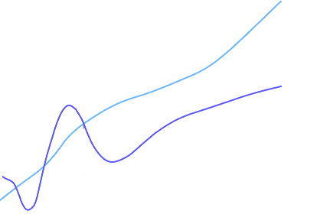

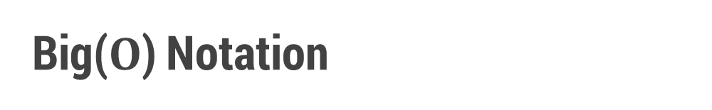

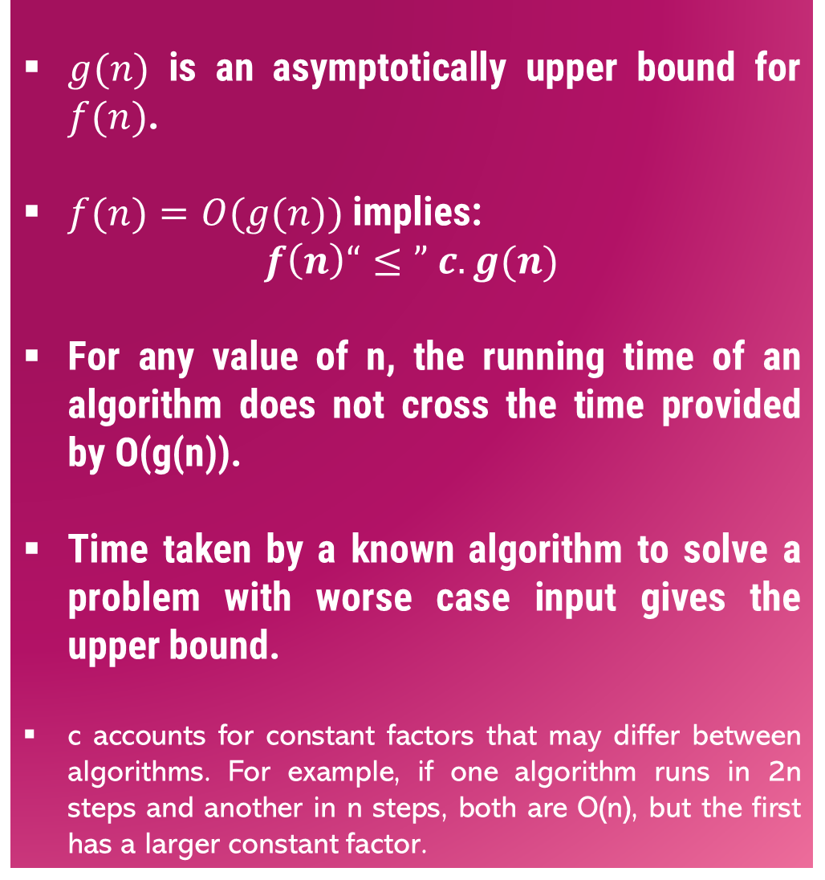



Big($O$) Notation
$g(n)$ is an asymptotically upper bound for $f(n)$.
$f(n)=O(g(n))$implies:
$$f\left(n\right)“≤” c.g(n)$$
For any value of n, the running time of an algorithm does not cross the time provided by O(g(n)).
Time taken by a known algorithm to solve a problem with worse case input gives the upper bound.
c accounts for constant factors that may differ between algorithms. For example, if one algorithm runs in 2n steps and another in n steps, both are O(n), but the first has a larger constant factor.
$$c.g(n)$$
$$f(n)$$
$$n$$
$$n_{0}$$
$$f(n)=O(g(n))$$

Slide 24
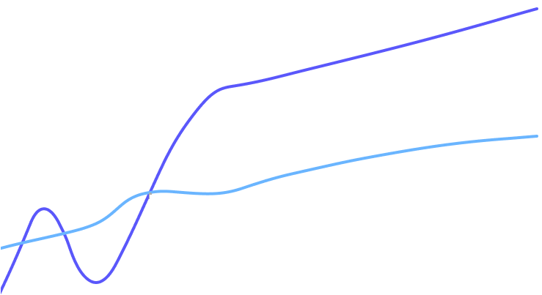

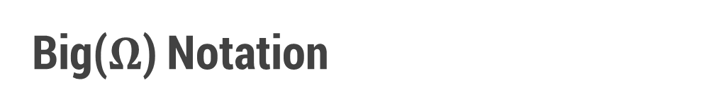
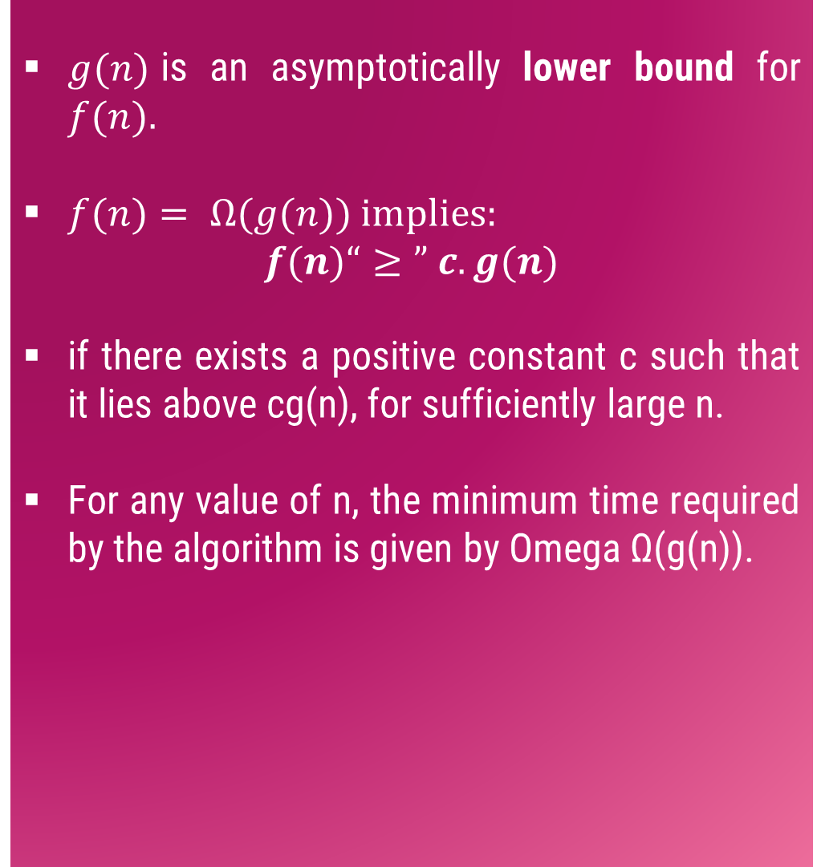


Big($Ω$) Notation
$g(n)$is an asymptotically lower bound for $f(n).$
$f(n)= Ω(g(n))$implies:
$$f(n)“≥” c.g(n)$$
if there exists a positive constant c such that it lies above cg(n), for sufficiently large n.
For any value of n, the minimum time required by the algorithm is given by Omega Ω(g(n)).
$$f(n)$$
$$c.g(n)$$
$$n$$
$$n_{0}$$
$$f(n)=Ω(g(n))$$

Slide 25
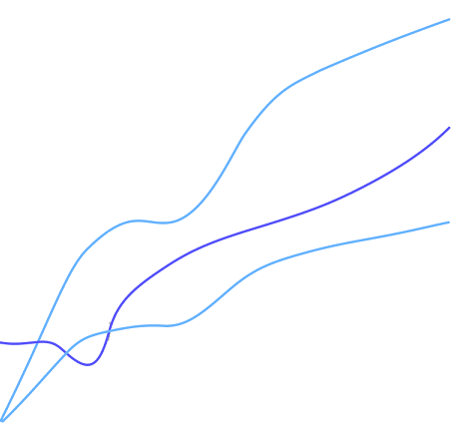

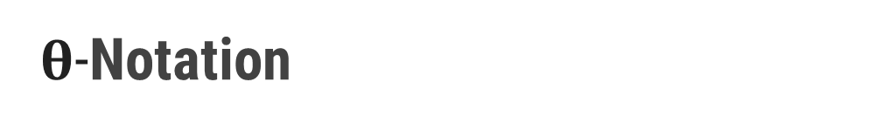
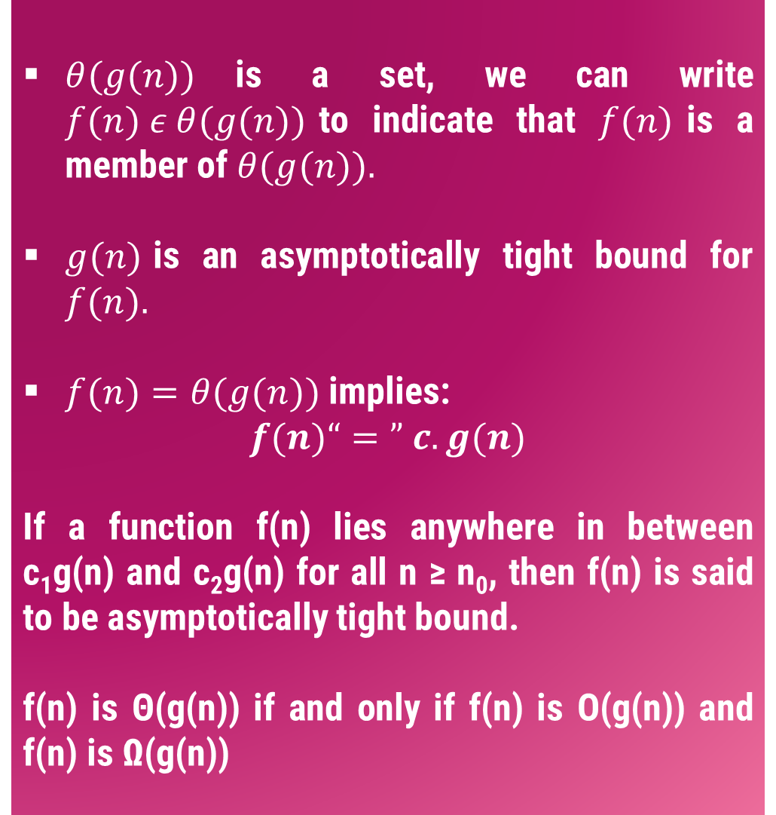





$θ$-Notation
$θ(g(n))$is a set, we can write $f(n) ε θ(g(n))$to indicate that $f(n)$is a member of $θ(g(n)).$
$g(n)$is an asymptotically tight bound for $f(n).$
$f(n)=θ(g(n))$implies:
$$f(n)“=” c.g(n)$$
If a function f(n) lies anywhere in between c₁g(n) and c₂g(n) for all n ≥ n₀, then f(n) is said to be asymptotically tight bound.
f(n) is Θ(g(n)) if and only if f(n) is Ο(g(n)) and f(n) is Ω(g(n))
$$c_{2}.g(n)$$
$$f(n)$$
$$c_{1}.g(n)$$
$$n$$
$$n_{0}$$
$$f(n)=θ(g(n))$$

Slide 26
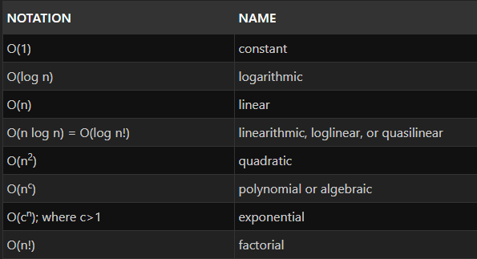
Common Asymptotic Notations

Slide 27
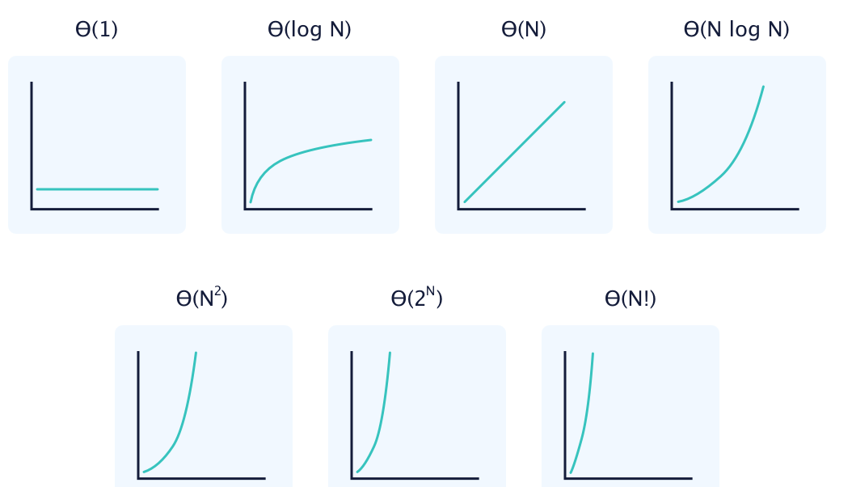
Common Asymptotic Notations

Slide 28

Efficiency of an Algorithm – Does it Matter?
Different algorithms, constants & hardware proficiency
Problem: Sort 10 million numbers
Computer A: insertion sort, 10bi/s, c1=2
Computer B: merge sort, 10mi/s, c2=50
Computer A:
Computer B:

Slide 29
Complexity: Simple rule
Drop lower order term and constant factor
O(1000 n) = O(n)
O(n2 + 3n + 2) = O(n2)
O(3n3 + 6n2 - 4n + 2) = O(3n3) = O(n3)
If f(x) = n2 * log n = O(n2 log n)
Comparing asymptotic running time:
an algorithm that runs O(n) times is better than one that runs in O(n²) times
similarly, O(logn) is better than O(n)
Hierarchy of function: log n < n < n² < n³ < 2^{n}

Slide 30
Complexity of an Algorithm
for (i = 0; i < n; i++)
for (j = 0; j < n; j++)
cin >> A[i][j];
Number of times cin >> A[i][j]; executed: n² Complexity: O (n²)
In a nested for loop with fixed lower and upper limits (e.g. "0" and "n") the number of times the insider part is executed is just n x n. f(n) = n² . So this program section runs in O(n²) time.

Slide 31
for (i = 0; i < n; i++)
for (j = 0; j < i; j++)
cin >> A[i][j];
The inner loop is executed a variable number of times; we can't just multiply n by i:
When i = 0 the inner loop is executed 0 times. When i = 1 the inner loop is executed 1 time. When i = 2 the inner loop is executed 2 times. So the number of times the statement "A[i][j] = 0" is executed is: 1 + 2 + 3 + ... + n = n(n+1)/2 = ½(n²+n) Ignore leading constants (the 1/2 in the equation above) and lower order terms (the n in the equation above), this algorithm runs in O(n²) time.

Slide 32
Dim Sum,i,j,k As Integer
For i = 1 to n
For j = 1 to n
Sum = Sum + 1 | = 1 x n
end for
For k = 1 to 2 *n
Sum = Sum + 1 |
Sum = Sum + 1 | = 3 x 2n
Sum = Sum + 1 |
end for
end for
Number of times executed: n x (1 x n + 3 x 2n) = n² + 6n² = 7n² Complexity: O (n²)

Slide 33
void main(void)
{
int i, tofind, A[100], n;
i = 0;
cin >> tofind;
while ((A[i] != tofind) && (i <= n))
i++;
if (i >= n) cout << "not found";
else cout << "found";
}
Complexity: O (n)

Slide 34
1. i = n; // i starts from n
2. while (i >= 1)
3. {
4. x = x + 1; // count this line
5. i = i / 2; // i becomes half at the end of every iteration
6. }
iteration | value of i (at the top of loop) | number of times line 4 is executed
1 | n/2⁰ | 1
2 | n/2¹ | 1
3 | n/2² | 1
k | n/2^{k-1} = 1 | 1
k+1 | n/2^{k} = 0 | 0 (loop not executed)
Complexity: O (log₂ n)

Slide 35
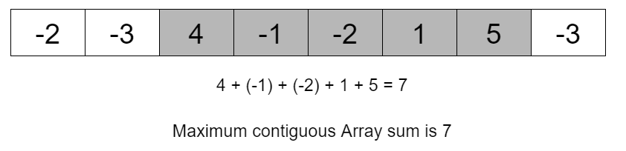
Example Problem
Given an array of n numbers, the task is to calculate the maximum subarray sum. The largest possible sum of a sequence of consecutive values in the array.

Slide 36
Approach 1
int subarray_sum(int nums[], int n)
{
int max = 0; or -inifinity
for(int i=0;i<n;i++)
{
for(int j=i;j<n;j++)
{
int sum=0;
for(int k=i;k<=j;k++)
sum+= nums[k];
if(sum>max)
max = sum;
}
}
return ans;
}
Complexity O(n³)

Slide 37
Approach 2
int subarray_sum2(int nums[], int n)
{
int max=0;
for(int i=0;i<n;i++)
{
int sum=0;
for(int j=i;j<n;j++)
{
sum+= nums[j];
if(sum>max)
max = sum;
}
}
return ans;
}
Complexity O(n²)

Slide 38
Approach 3
int subarray_sum3(int nums[], int n)
{
int max = 0, sum = 0;
for(int i=0; i<n; i++)
{
sum = sum+ A[i];
if (sum > max)
max = sum;
if (sum < 0)
sum = 0;
}
return ans;
}
Complexity O(n)

Slide 39
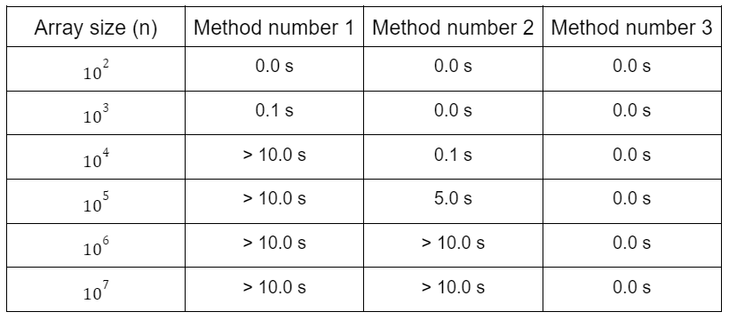
Comparison of Approaches
Source: https://www.geeksforgeeks.org/knowing-the-complexity-in-competitive-programming/

